Slide 1
LIFE SKETCH OF DR. SAMUEL HAHNEMANN

Slide 3
BIRTH OF HAHNEMANN
Meissen in Germany
– famous city of Porcelain Industry with gigantic chimneys which almost touch the sky, uninterrupted stream of workers & job seekers kept Meissen alive.
Many painters and experts in chemistry lived there
Beyond this, rivers Elbe and Meissa join together to present the people glorious dusks.
With a chill breeze went around Meissen
IT was here………….

Slide 4
Father of homoeopathy- CHRISTIAN FRIEDRICH SAMUEL HAHNEMANN was born..

Slide 5
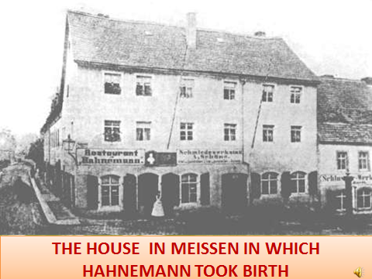

Slide 6
Christoph hahnemann
Christoph hahnemann, whose work was closely related with porcelain industry was the grand father of SAMUEL HAHNEMANN. Christian gottfried hahnemann, the father of Samuel Hahnemann was the fifth son among 7 children of Christoph Hahnemann.

Slide 8
Christian gottfried hahnemann
He was a genius. He had a unique style of excellence in painting and sculpture. Had a special interest in drawing scenery and inflorescence on porcelain pots and utensils.
He married johanne eleonore deerens on 27th nov.1748. it was short lived as she succumbed to the fate with the first delivery.
After about 1 year on 2nd november 1750 Gottfried Hahnemann married Johanna christiane speissen to them was born as a third child (among three sons and two daughters) DR. SAMUEL HAHNEMANN on the 10th April 1755.

Slide 9
Christian gottfried hahnemann’s children
Charlotta Gerhaduna Hahnemann (29th Jan 1752)
Carl Gerhard Hahnemann (8th Jan 1754)
Samuel Hahnemann (10th April 1755)
Samuel Dugust Hahnemann (30th July 1757)
Benchamina Hahnemann.

Slide 10
Dr. samuel hahnemann’s child hood (1755-1767)
)
Because of the fragile life of child and poverty of parents, Hahnemann education began at home
Hahnemann’s moral training began with his father who taught him by words and practice ‘to act and live without any pretends or show’.
To bring him as a man of common sense his father gave him some questions or arithmetic puzzles to be solved. This led to new queries and formulate well fitting answers to these through self debate.

Slide 11
Educational Period (1765-1779)
Hahnemann was admitted to the Town School at Meissen on July 20th 1767 at the age of 12 in class 2, from there he went to Prince School in November 1770.
As he was a brilliant student he won the attention of his teacher of whom Rector Muller deserves special mention.
In the School he took much interest in the study of Language. This made him to master different languages like French, English, Italian, greek, Hebrew, Arabic, Spanish,latin,cheldiac and german

Slide 12
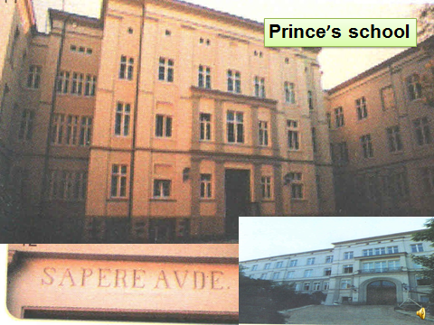

Slide 13
He even made a herbarium of his own. He was asked by his teacher to teach the rudiments of Greek and Latin to its fellow students.
He also showed special care and taste to study botany.
As his father was too poor to afford education, he did not encouraged Hahnemann in his studies. He pulls even for a whole year to pressure some business.
But the teachers prevented him from stopping his education and they help by not accepting school fees from him.
Inspite of all these Hahnemann worked hard and he studied late in night.
Hahnemann’s education suffer due to his poor health Rector Muller used to excuse him and allowed him to be absent in classes or subjects which are little interest for Hahnemann

Slide 14
His father sends Hahnemann to work in a Grossary store so that he would become a merchant later.
But again, Hahnemann returned home to continue his studies.
In 1775 Hahnemann delivered his leave taking speech at the Prince School. As was the custom and the topic was the ‘Wonderful Construction of Human Hand’.

Slide 16
At Leipzig
In 1775 Hahnemann set out for Leipzig for the 2nd time for medical education with just 20 thallers in hand.
In the path of chasing his dream to become an eminent physician, he immersed himself in his studies round the clock.
Hahnemann joined the Leipzig University and started his medical education.
Hahnemann began his student days at Leipzig by attending lectures during day time and devoting his night to translations from English to German.
He also gave tuitions in German to and English to young Greek. he gave tuition for the sole purpose of earning his bread and butter.

Slide 17
He attended lectures which he considered useful and he found out that there was no practical facility in Leipzig University.
The four important Book Hahnemann translated from English to German are:
John Stedman’s Physiological Essays
Nugen’s on Hydrophobia
Falconer’s ‘On the waters of Bath’ and
Ball’s Modern Practice of Physic. (Art of Medicine)
He also had written many poems.

Slide 19
At Vienna (1776)
At Vienna he was played upon by a malicious trick and was robbed of his money.
So he was compelled to live on 68 thallers for 9months.
At Vienna he joined the famous hospital of ‘Brothers of Mercy’ which had better hospital facilities in which maternal and child health centre as well as asylum for insane are affliated to it.
There he became the favorite pupil of Dr. Von Quarine, a renowned physician of his time.
Dr. Von Quarine taught him without his usual fees and even allowed Hahnemann to accompany him to his private patients.

Slide 20
Dr. Von Quarine secured for him the post of family physician and librarian of Baron Von Brukenthal the Governor of Transylvania to bear his poor economical status.
So Hahnemann travelled from Vienna to Hermannstedt. Arrangements were made for Hahnemann,s accommodation at the free maison’s a lodge for dignitaries and distinguished personalities.

Slide 21
At Hermannstedt
He carefully cataloged Governor’s library and classified his extensive coin collection.
He attain extensive and divert knowledge of ancient literature and occult sciences
He devoted his leisure time reading philosophy and metaphysics and also practiced medicine in the evening. By the time Hahnemann was about to leave Hermannstedt, he was a master of Greek, Latin, Italian, Hebru, Arabic and Spanish. In order to complete his medical studies, he arrived at Erlangen.

Slide 23
At Erlangen
Hahnemann chose Erlangen University because the fee was cheaper when compared to Leipzig.
In 1779 at the age of 24yr, after much hardship and struggle, he got his degree of Doctor of Medicine from the University of Erlangen on his thesis: “A Consideration of Etiology and Therapeutics of Spasmodic Affection”.

Slide 24
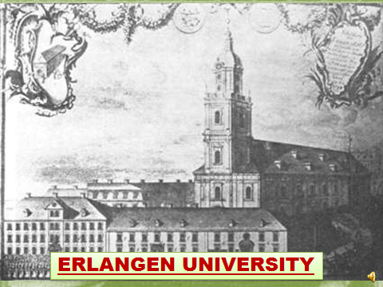

Slide 26
Medical Practice and Marriage (1779-1789)
After he took his medical degree in 1779, he started his medical practice in Copper mining town of Hettstadt.
Here he started publishing his writings in Krebs’s medical observation.
Through his original works and translations his name became known to the medical world.
After 9 months of stay in Hettstadt he left for Dessau which is just 50km away in 1781.

Slide 27
At Dessau
Here he turned his attention to chemistry. His Interest in chemistry brought him in contact with an apothecary i.e. Herr Haesler.
There he conducted many new experiments.
During the later months of 1781, he was appointed as Medical Officer of health of Gommern.
During this period fell in love with the step daughter of Herr Haesler, Johanna Leopoldine Henrietta Kuchlerin.
Hahnemann settled at Gommern and started his medical practice. He also resumed his literary works.

Slide 28
He was attracted to the words of Demachy and translated his works to German. He still continued his study on chemistry.
The book was ‘Demachy’s art of manufacture in chemical products’. He also published a book, his first medical work, i.e.‘Directions for Curing old Sores and Indolent ulcers’ in 1784.
In this work he lamented about the absence of any principle for dissolving the curative powers of medicine i.e. want of any principle for the administration of drug in diseases.
By this time in 1783, Hahnemann first daughter Henrietta was borned.
Hahnemann enjoyed a happy peaceful home life. Though he started practicing as a physician, the uncertainties and confusions regarding the action of medicine disappointed him

Slide 29
He gradually became dissatisfied with the system of treating.
He could not treat unknown morbid condition of his suffering brothers by unknown remedies applied vigorously and massively which in turn create new maladies.
From Gommern he left for Dresden in 1784.

Slide 31
At Dresden (1784-1789)
Hahnemann changes the residence from sleepy town of Gommern to Dresden, the centre of arts and science, literary works.
During that period he didn’t practiced the medicine.
Dr. Wagner, the medical officer of health offered him the opportunity of professional activities of Forensic Medicine.
During the years of 1787-1790, Hahnemann published more than 2200 printed pages including translations, original works and essays. This includes German translation of the English story ‘History of the lives of Abelard and Heloise’ of Sir Joseph Barrington

Slide 32
In 1786, Hahnemann published his 1st much applying and celebrated chemical- forensic work, ‘On Poisoning by Arsenic’. Hahnemann was a master of practical chemistry and this displayed Hahnemann’s immense knowledge. To this day, it is considered important translations from French to German are:
Demachy’s art of manufacturing vinegar (1787)
Detection of purity and adulteration of drug (1787) in this he added some of his experiments in chemistry.

Slide 33
Other Chemical works during that period are
On the difficulties of preparing soda from potash and kitchen salt (1787)
On the test for iron and lead in wine (1788)
On the bile and gall stones (1788)
Discovery of new constituent in Plumbago (1789)
Articles to prohibit the use of arsenic as it had many disastrous side effects.
In this year hahnemann’s mother passed away..

Slide 34
Important Medical Work
Instructions for surgeon respective of general disease together with a new mercurial preparation (1789) by Samuel Hahnemann
Hahnemann’s discovery of new mercurial preparation is known as Hahnemann’s Mercurius solubilities and this name still present in German Pharmacopoea

Slide 35
Events that lead to the discovery of Homoeopathy (1790-1809)
As a medical practiser, Hahnemann was not satisfied with the system of medicine, so he learn more towards the literary works for the support of the family.
In 1790 Hahnemann started the translation of William Cullen’s ‘A treatise of Materia Medica’ from English to German. What happened to Newton by falling of an apple in his head, happen to Hahnemann while translating Cullen’s Materia Medica.
As Hahnemann’s mind was always on the look out for some guiding principle in the selection of medicine for disease, he was struck with the unsatisfactory explanation of Cullen regarding the anti pyretic power of Cinchona

Slide 36
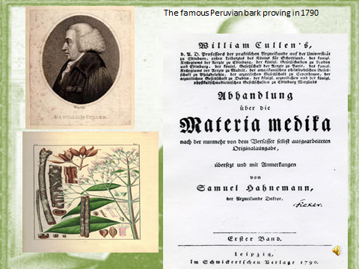

Slide 37
Cullen remarked that the bitterness of cinchona was responsible for curing the intermittent fever.
The scientific mind of Hahnemann refused to accept this because there were plenty of other bitter drugs which do not possess the ague curative power.
So in order to find out the effects of cinchona, Hahnemann decided to experiment it on himself. He took 4 drachms of cinchona juice twice a day and was taken down with symptoms similar to that of malaria
Hahnemann experienced all the ordinary symptoms of intermittent fever including chill stage, heat stage and sweat stage and the paroxysm lasted 2-3 hrs each time he take it.
When he stops taking cinchona juice, the symptoms disappeared and he became healthy again.
Thus he get the idea that drugs can cure those symptoms in a sick person, which they are capable of producing in a healthy individual.

Slide 38
For a few yrs, Hahnemann experimented with few more drops on himself and his family members.
He became convince that drugs were capable of producing artificial disease symptoms in a healthy individual similar to that of a natural disease to which they are supposed to be specific i.e. the disease producing power of a drug in the disease curing power.
Hahnemann already know about the nature’s way of curing disease i.e. curing a chronic disease by super adding another which is very stronger and similar to the former in its manifestation i.e. the natures law of cure- ‘SIMILIA SIMILIBUS CURANTUR’ (like cured by likes)
i.e. let a disease be cured by a medicine which has the power to produce a similar artificial disease in a healthy individual. This is the axiom on which Homoeopathy is placed.

Slide 39
In the year of 1790, Hahnemann moves to Leipzig to be nearer the fountain of science.
He gave up his medical practice and has to support his family entirely with his literary works.
During this period Hahnemann’ economical condition was poor. Hahnemann had a poor family and had nothing to depend on except the literary works on translations and chemical discovery.
The quantity of bread he was able to earn by his writings was so small for his large family. He lived in this family in a single room separated by a curtain. After toiling for the whole day he translates his work on the press. Hahnemann assisted his wife to wash the clothes in night.
In his autobiography Hahnemann wrote “4 daughters and one son together with my wife constitute the spice of my life”.

Slide 40
In 1791 Hahnemann moved out of Leipzig.
In 1792, Hahnemann was appointed as the manager of a mental asylum at Georgenthel as he was famous for advocating humane treatment for mental patient.
The 1st patient was Klokenberg the Hanoverian minister of police.
Klokenberg became the subject of drama by a German dramatist. In the drama he was acted as a subject of fraud and this caused him to develop great eccentricities.

Slide 41
He had already been treated in the usually barbaric manner of the period in an asylum with no benefit.
Hahnemann treated this dangerous lunatic on a non-restrained plan without the use of chains or corporeal punishment which was in universal use at that time.
Hahnemann carefully watched the patient for 2weeks without giving any medicine.

Slide 42
Later the patient was given a preparation of tartar emetic and was cured of the disease. Hahnemann received a fee of 1000 thallers for his successful treatment.
But unfortunately no more patients were coming for treatment in asylum and Hahnemann had to move out of Georgenthel

Slide 43
For the next few yrs Hahnemann wandered and traveled to many places.
An accident occurs on the way to Muhlhausen and the youngest child Ernest was killed and there was serious injury to others.
From Georgenthel he left to Molesleban and then to Muhlhausen then to Unstredt then to Pyrmone then to Koningsluttar.

Slide 44
Literary Works during the period 1791-1809
In 1792, Hahnemann published the first volume of ‘Friend of Health’. In 1795 the 2nd Volume of ‘Friend of Health’ was published.
This book was on public health and hygiene, it is a master piece on social and individual hygienic measures.
In 1793, Hahnemann published ‘Pharmaceutical Lexicon’. It is fundamental work on the art of pharmaceutics and it has been widely used by pharmacist as a guide line.
Also in 1793 itself, Hahnemann was regarded as the famous Analytical Chemist by the journal Krells Annals

Slide 45
In 1794 Hahnemann published another work ‘On Hahnemann’s new wine test and new liquor probatorius fortior”.
During that time the commercially available wine was most frequently adultered with silver or lead.
Drinking of such wine will produce spasm or colic and it may later prove fatal and also the method prevalent at that time for testing wine was not satisfactory.
As these materials are destructive to the health of man, Hahnemann after extensive chemical investigation discovered a reliable method for testing the adulterants in wine

Slide 46
In 1796, at the age of 41 years i.e. after 6yrs of constant study, experimentation and practical application published an epoch making essay in Hufeland’s Journal ‘Essay on the new principle for ascertaining the therapeutic powers of drugs’.
In this essay he explains the discovery of new principles of cure i.e. Similia Similibus Curenter i.e. let likes to be cured by like and the need to prove drugs on healthy human being to study the proper action of a drug.
Thus 1796 is regarded as the year of birth of Homoeopathy.

Slide 47
In 1797, Hahnemann wrote his idea of simple medicine in treatment in an essay ‘All the obstacle to the attainment of simplicity and certainty in practical medicine insurmountable’.
Other works in 1797, one is ‘Something about the pulvorisation of Ignatia beans’,
‘Antidote to some heroic vegetable substance’.
In 1800, Hahnemann published a translatory work ‘Thesaurus Medicaminum’.
In 1801, Hahnemann published two works; they are ‘Observation on the three current methods of treatment’, ‘Cure and prevention of Scarlet fever’.

Slide 48
During the last year of stay in Koningsluttar, a severe epidemic of scarlet fever broke out;
Hahnemann observed that the first stage of scarlet fever was always presented with inflammation, redness and congestion.
As he knew that a similar state can be produce by the powers of Belladonna and is a great philatic to scarlet fever.
He was convinced about the fact became when he administered Bell to the 4th younger child in a family of 3 infected children, the 4th can escape infection during epidemic.
In 1803 Hahnemann published 2 works they are, ‘On the proposal remedy for Hydrophobia’, ’Coffea and its effects’.

Slide 49
In 1805, Hahnemann being 50yrs of age published 2 works of great importance,
1. Aesculapius in balance which takes a general survey of traditional medicine and pronounces on the verdict ‘Weighted in the balance and found wanting’. It critically analyses the allopathic mode of practice.
2. ‘Fragmenta De Veribus Medica Mentorum Positives Sive Invano Corporo Humano Observatives’. It is an authoritative book on the pure experimental proving of medicine healthy human being.

Slide 50
In 1806 after 16years of unremitting work observation, experimentation and research Hahnemann published ‘Medicine of Experience’, which contains the first complete exposition of homoeopathic mode of administering medicines.
Medicine of Experience is considered as the precursor of Organon, which Hahnemann published later in 1810.
The art of medicine was at last placed on a scientific footing when Hahnemann changes the medical speculations which existed since time immemorial into Medicine of Experience

Slide 51
In 1806 itself Hahnemann published the last work he translated i.e. Haller’s Materia Medica,
Haller being one of Hahnemann’s former in recommending the testing of drugs on healthy human being.
In 1807 Hahnemann first used the word ‘Homoeopathy’ in the title of an article contributed to Hufeland’s journal i.e. ‘Indication of Homoeopathic Employment of medicines in ordinary practice’.
In 1808, Hahnemann published ‘On the prevailing fever’ which sharply criticize the therapeutics prevailing at that time

Slide 52
Publication of Organon of Medicine (1810-1833)
In 1810 Samuel Hahnemann published the fundamental book on Homoeopathy i.e. ‘Organon of rational art of Healing’ 1st edition and for the first time new system of healing was called Homoeopathy and the book gave a scientific basis to Homoeopathy.
Immediately after the publication Hahnemann was attacked by the medical journals of the day, books and pamphlets were published against him and his trained doctrines.
He was called quack and an ignorant.
His minimum doses were declared as an impossible.
The tests of medicine on healthy human being were considered ridiculous.
Hahnemann braved the criticism which he received from every quarter and stood firmly by his principle ‘Dare to be Wise’.

Slide 53
From 1811-1821, he published six volumes of Materia Medica pura.
it consist of pure and detail record of symptoms of medicines proved on healthy human being.
In 1812 Hahnemann give up all hope of influencing the older men in profession and determined to proceed to Leipzig and devote himself in teaching the medical students of Leipzig University.
So at the age of 56, he moved to Leipzig again and eagerly waited to teach in Leipzig University.
At first the dean of the University rejected the application. Because certain conditions had to be fulfilled before he could get permission. He had to write a thesis and defined it before the faculty of University and also had to pay fee of 50 thallers.

Slide 54
So Hahnemann wrote and read this thesis entitled ‘A medical Historical dissertation on the helleborism of ancients’.
In this essay he coated from 8 languages on the medical effects of Veratrum album.
The authorities were impressed and permitted Hahnemann to teach in the Leipzig University.
During their time he gathered an enthusiastic who helped him in proving medicines and also in propagating Homoeopathy

Slide 55
In 1813 Hahnemann published ‘The sprit of Homoeopathic medical doctrine’.
In 1816 Hahnemann wrote an essay on the treatment of burns.
In it he illustrated with facts and logic that in case of burns cure talus place only if we treat Homoeopathically, by using warm water instead of cold water.
In 1819Hahnemann published the 2nd edition of Organon, Organon of healing art.

Slide 56
In 1820, the antagonism and criticism against Hahnemann increased due to the death of his long time celebrity person Prince Schwaezenverg while under Hahnemann’s treatment for paralysis.
Actually the death was due to the renewal of one of his old habit i.e. his excessive drinking, but the public put blame of Hahnemann.
Also in 1820 itself the Apothecaries took action against him for preparing and dispensing his own medicine.
The persecution was at last successful and the forceful Saxon Government disallowed Hahnemann to dispense and practice medicine and imposed strict restriction upon Hahnemann which made him move out of Leipzig.

Slide 57
Hahnemann went to Kothen and contacted Duke Ferdinand of Anhalt-Kothen.
In order to obtain permission for practicing Homoeopathy at Kothen. Dr. Adam Muller who had a great influence upon duke convinced the Duke of all situations.
Thus in April 1821 admit the antagonism of allopaths, pharmacists and Govt: of Anhalt-Kothen gave Hahnemann to settle and practice Homoeopathy in Kothen

Slide 58
In1824, 3rd edition Organon of Medicine was published. By this time Hahnemann famous practitioner.
During the period 1824-1828, Hahnemann had abundant opportunity in observing the symptom and course of chronic disease.
Thus after tired less investigation, accurate observation and most careful experimentation he came out with a medical work of great important in 1828 i.e. ‘Chronic Disease, their nature and Homoeopathic treatment”, in which he details about the fundamental cause of all diseases.

Slide 59
In 1829 Aug 10th –hahnemann’s 50th doctor’s Jubilee was celebrated.
A festival was organized on that special day to celebrate the 50th jubilee ,one model and the famous painter Kruger of Dresden made a good oil painting of Hahnemann, a modal pertaining Hahnemann bust was also brought out.
Stapf presented him with a copy of Lesser Writings of Hahnemann which himself had collected.
The most important happening of that day was finding ‘the society of Homoeopathic Physicians’. 4th edition of Organon of Medicine was published.

Slide 60
On March 31st 1830, Hahnemann lost his 1st wife at his 75th year.
She had been his constant companion for 49 yrs. of his married life and had gone his 2sons and 9 daughters.
In 1831 an epidemic of cholera broke out, in Prussia and Kothen.
During this time Hahnemann wrote about cholera, its infection and transmission in an essay “Appeal to the Thinking Philanthropists respecting the mode of propagation of Asiatic cholera’.
Hahnemann described the cause as small living organisms. He was the 1st one to organize the bad effects of unhygienic conditions as the contributing cause and spread of disease.
He was not only a man of science but endowed with a sense of prescience Robert Koch discovered the bacteria.

Slide 61
Vibrio Cholerae and its transitions by contaminate food, water and clothing and proposed the famous Germ theory of disease during 1814. But earlier in 1831 itself Hahnemann predicted the role of infinitely small living organism in the spread of cholera.
In 1833. Hahnemann published the 5th edition of Organon of Medicine. Also in 22nd Jan 1833 is considered as the new era in Homoeopathic world i.e. the1st Homoeopathic hospital and clinic was started at Gloken’s Strasse of Leipzig.
In 1834,hahnemann,who had not visited leipzig for thirteen years,went again to share in the june celebrations of the homoeopathic hospital in that city.
In 1835 Hahnemann remarried, nearly 5 yrs after the death of his wife, a brilliant and talented lady came to Kothen to learn more about homoeopathy from Samuel Hahnemann.
Their acquaint ended in 2nd marriage of Hahnemann in 80th yrs. and his bride Miss Marie Melania de Hervilly Gohiear being 35yrs old..

Slide 62
After the 2ndmarriage the criticism against Hahnemann increased not only among the apothecaries and public but also among his fellow Homoeopathic practitioners in Germany.
Madam Melania Hahnemann was an intelligent lady who held diploma given to her by the society of Homoeopathic Physicians, Pennsylvania. She used to handout prescription very effectively and was therefore a great relief to Hahnemann during his practice in old age.

Slide 63
Mélanie d‘ Hervilly
as a young woman

Slide 64
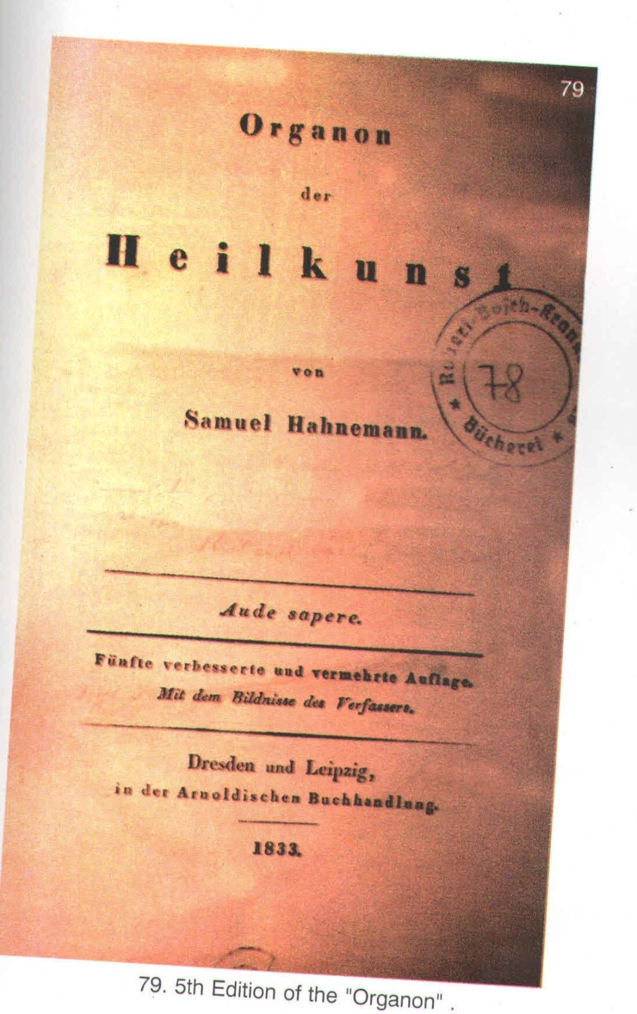

Slide 65
As the criticism increased, Madam Hahnemann perceived that it would be better for Hahnemann and Homoeopathy it Hahnemann left Kothen and made his home in Paris.
Through her influence with the Govt: she obtained a license for practice in France.
So in 1836 Hahnemann left for France with his 2nd wife. In France he got everything which is valued by a human being, i.e. recognition, honour, name, money, comfort and above all peace of mind.
Hahnemann and his wife move to Palatial Bungalow in Rudy Millen were he stayed during the last year of his life. Hahnemann’s life was filled with pleasure and luxury and it lasted for 8 yrs. French Homoeopathic physicians honoured him. His presence in Paris gave a great importance for the study and practice of Homoeopathy in Paris.
In 1842, Hahnemann announced the appearance of 6th edition of Organon but destiny took him away before he published it.

Slide 66
Hahnemann’s death and subsequent publication of 6th edition of Organon of Medicine
In the 1843 second July at 5am Hahnemann breath his last following a deep period of bronchial infection.
Before Hahnemann’s death he had completed the 6th edition of Organon of Medicine.
Hahnemann died at the age of 88yrs. For 9 days Madam Malanie kept her husbands body at home.
On July 11 1843 Hahnemann was buried in the cemetery of Mont Martre Hill in France. The immortal founder of Homoeopathy was buried like the poorest of the poor, only a few relatives attended the ceremony.
The outside world did not know much about Hahnemann’s death as it had been a private ceremony. But the Homoeopathic followers of later generation were not satisfied with the fore lone grey in the cemetery of Mont Martre to be their masters’ last resting place

Slide 67
So on 24 may 1898 the body was reburied and moved to Perelachaise, which is the abode of sacred and dignified man of France.
A beautiful monument was build with stands in 14 feet height in polished cortish granite. In the middle it is adorn with Hahnemann’s bust with an inscription ‘Hahnemann foundater de Homoeopath’, underneath his date of birth and death on the left his basic writings are sited, on the right the main thesis of Homoeopathy ‘Similia Similibus Curentar’ later a secondary inscription was added ‘Non Inutilis Vixy’ i.e. I have not lived in vain.
The 6th edition of Organon was published after 78 years of Hahnemann’s death.

Slide 68
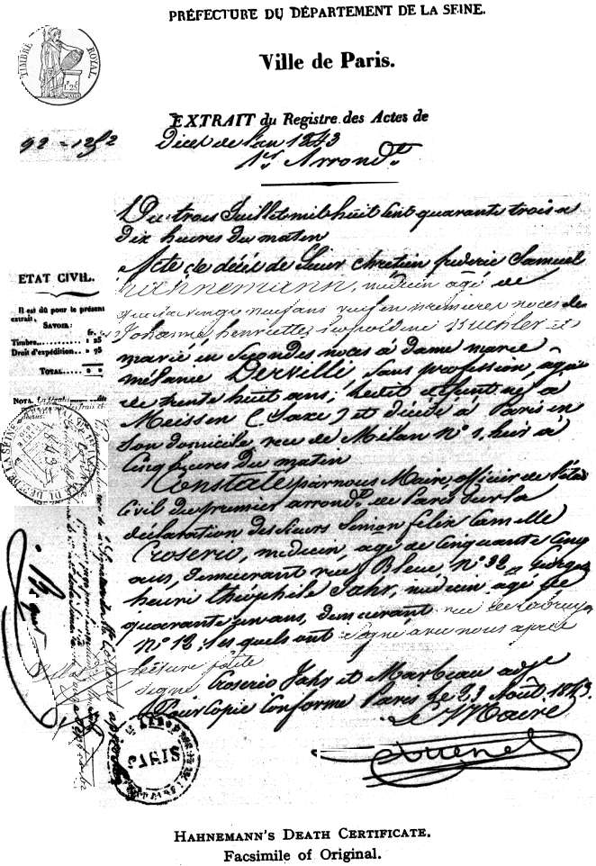
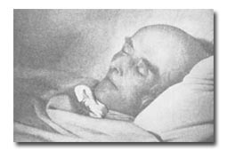
Hahnemann’s death certificate WRITTEN BY HIS OWN STUDENT JAHR

Slide 69
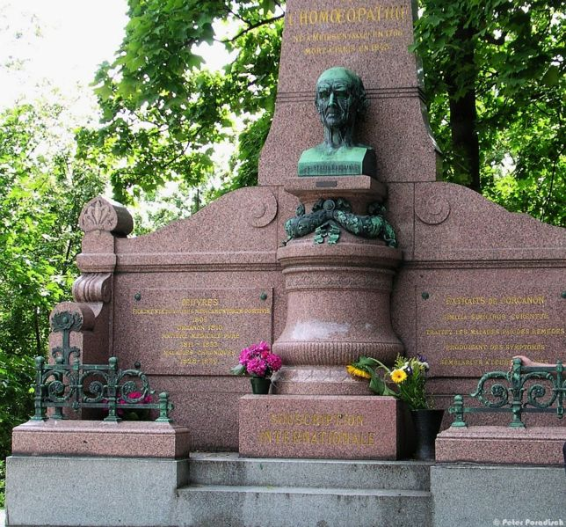
“NON INULITIS VIXI”
“I have not lived in vain”

Slide 70
Monuments to Hahnemann
The house in which Samuel Hahnemann was born on 11th april,1755 , was a corner house of three stories , whitewashed , simple and compact ,with wide windows admitting plenty of light. This ,with its cut away corner ,in which stands a bust of Samuel Hahnemann ,now serves as a restaurant to the neighbourhood . over the entrance an inscription reads “here was born Christian friedrich Samuel Hahnemann ,the founder of homoeopathy,”followed by date .
In Leipzig
“The statue of Hahnemann , not far off, appeared to me dignified and impressive ; on a lofty pedestal in one of the busiest centres of city traffic, flanked by a grove of tress, surrounded by flower beds. It is very conspicuous and the seats round it were crowded. Its german inscription reads “To the founder of homeopathy ,Samuel Hahnemann , born 1755, died 1843,from his grateful pupils and admirers “

Slide 71
In kothen
Kothen is adorned by a number of sculptured monuments and statues, and amongst them is the hahnemann “Denkmal,”placed at crossroads under the shadow of a wooded public park .
In paris
A beautiful monument was build with stands in 14 feet height in polished cortish granite. In the middle it is adorn with Hahnemann’s bust with an inscription ‘Hahnemann foundater de Homoeopath’, underneath his date of birth and death on the left his basic writings are sited, on the right the main thesis of Homoeopathy ‘Similia Similibus Curentar’ later a secondary inscription was added ‘Non Inutilis Vixy’ i.e. I have not lived in vain.

Slide 72
Provers union
As the proving of drugs on the healthy in order to elucidate symptoms they could call forth was an essential factor in Hahnemann ‘s method ,a band of “provers “ was formed that is , of persons willing to test drugs on themselves. The “provers ‘union” engaged in this difficult and important work formed the nucleus of hahnemann’s later corporate experiments in proving.
It included the names of stapf, gross, hornburg, franz, wislicensus, teuthorn, herrmann, ruckert, langhammer , hartmann, and Hahnemann himself .

Slide 73
In 1796 at Brunswick,in 1798 at konigslutter, in 1800 at altona and molln in lauenburg respectively .afterwards however Hahnemann did not treat any mental patient for any length of time and in the last case which he undertook that of the author, Wezel-he found by experience that home treatment is not suitable for all cases of insanity.

